Slide 1


Tetris Game
INTERNATIONAL UNIVERSITY OBJECT – ORIENTED PROGRAMMING
Group 24
Đào Huỳnh Thiên Long ITITIU19026
Đỗ Đông Quân ITITIU19043
Võ Huỳnh Huy Thịnh ITITIU19055

Slide 2
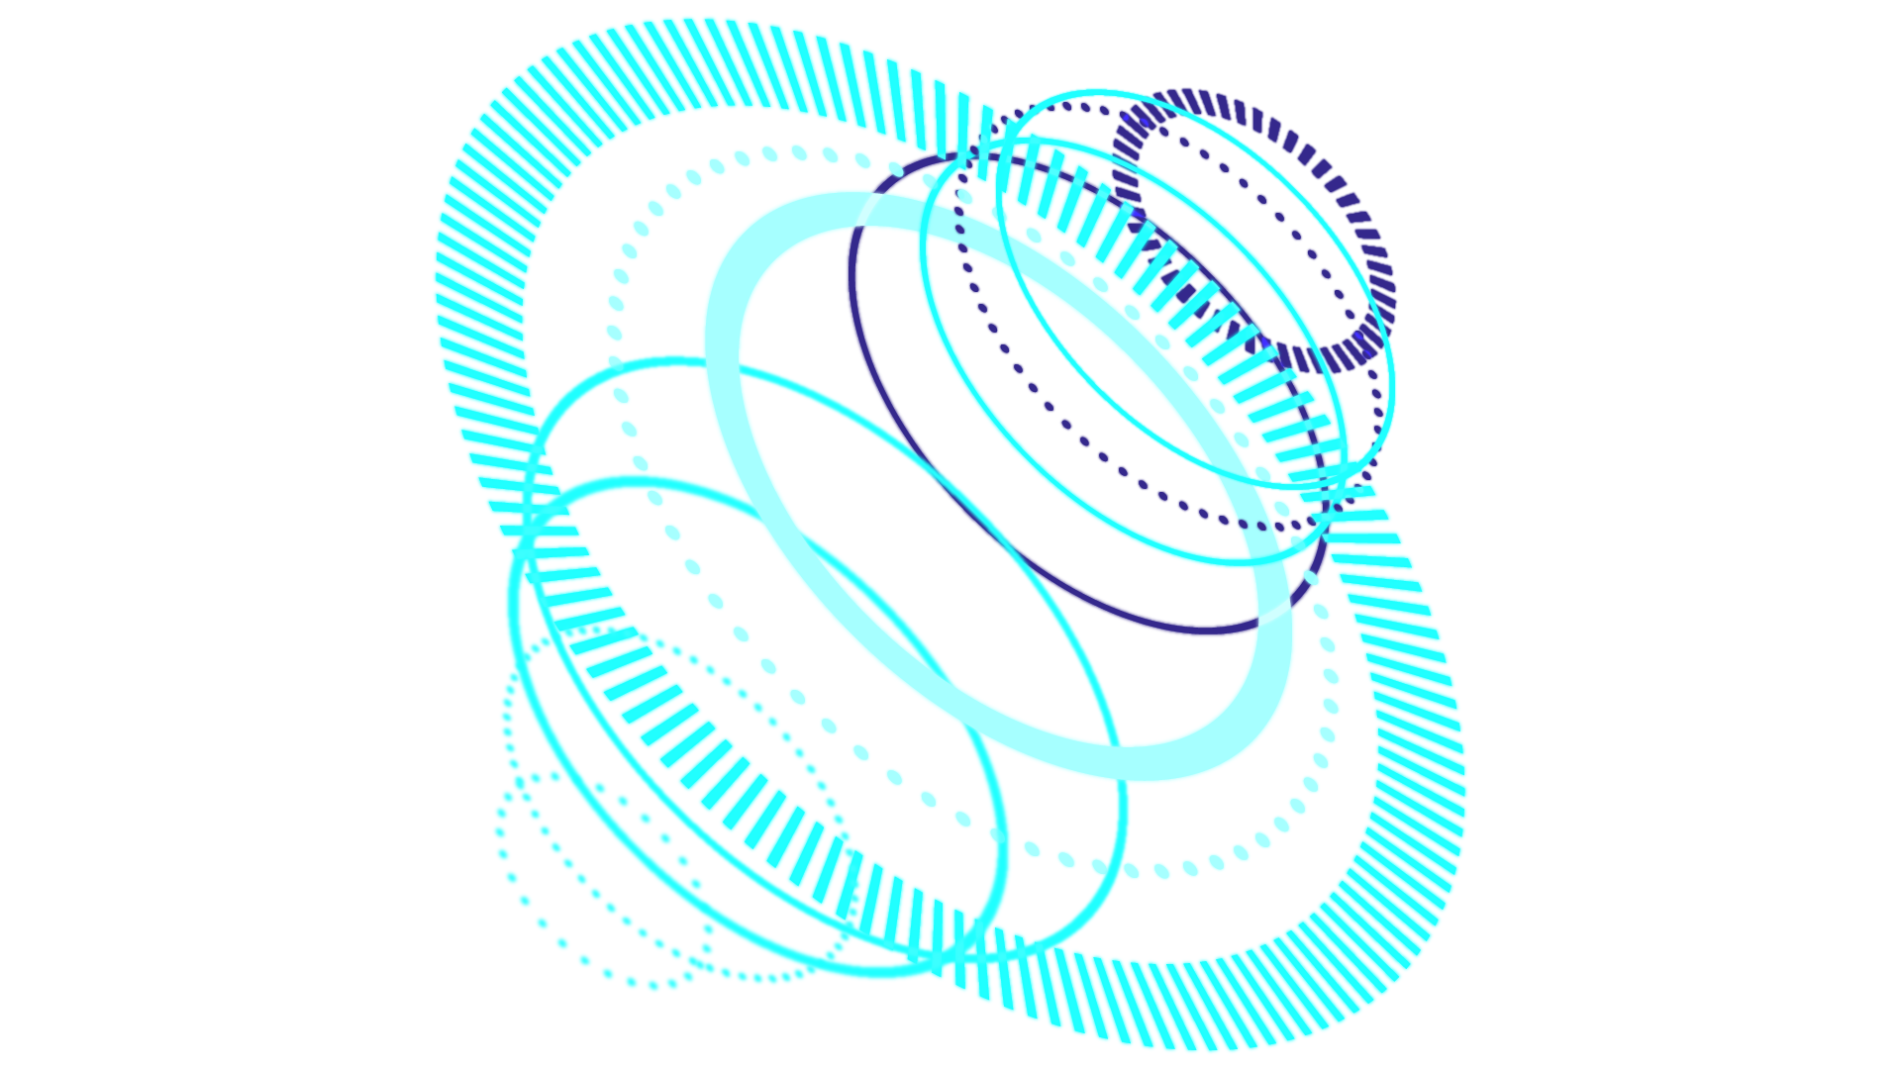
CONTENTS
Introduction
01
Shape Class
02
Board Class
03

Slide 3

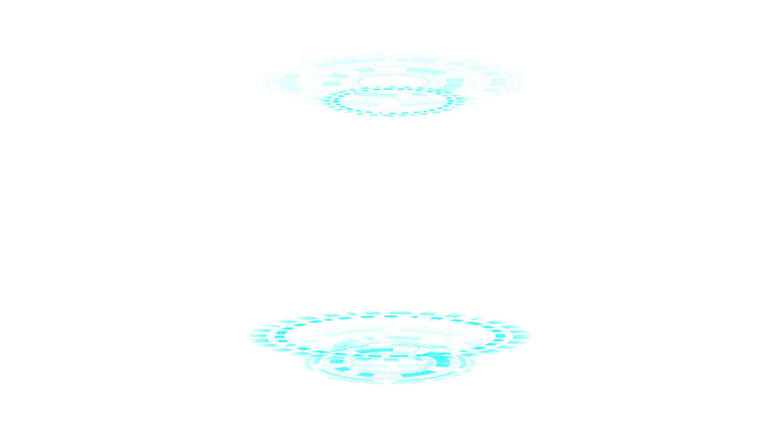
INTRODUCTION
The Tetris game is one of the most popular computer games ever created. Since then, Tetris is available on almost every computer platform in lots of variations.

Slide 4
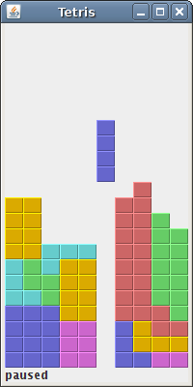
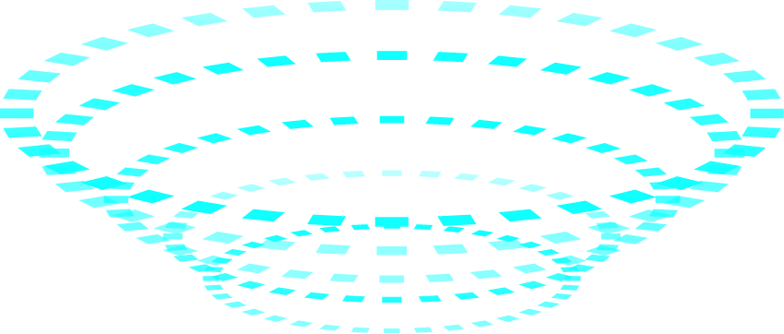
Figure: Tetris

Slide 5
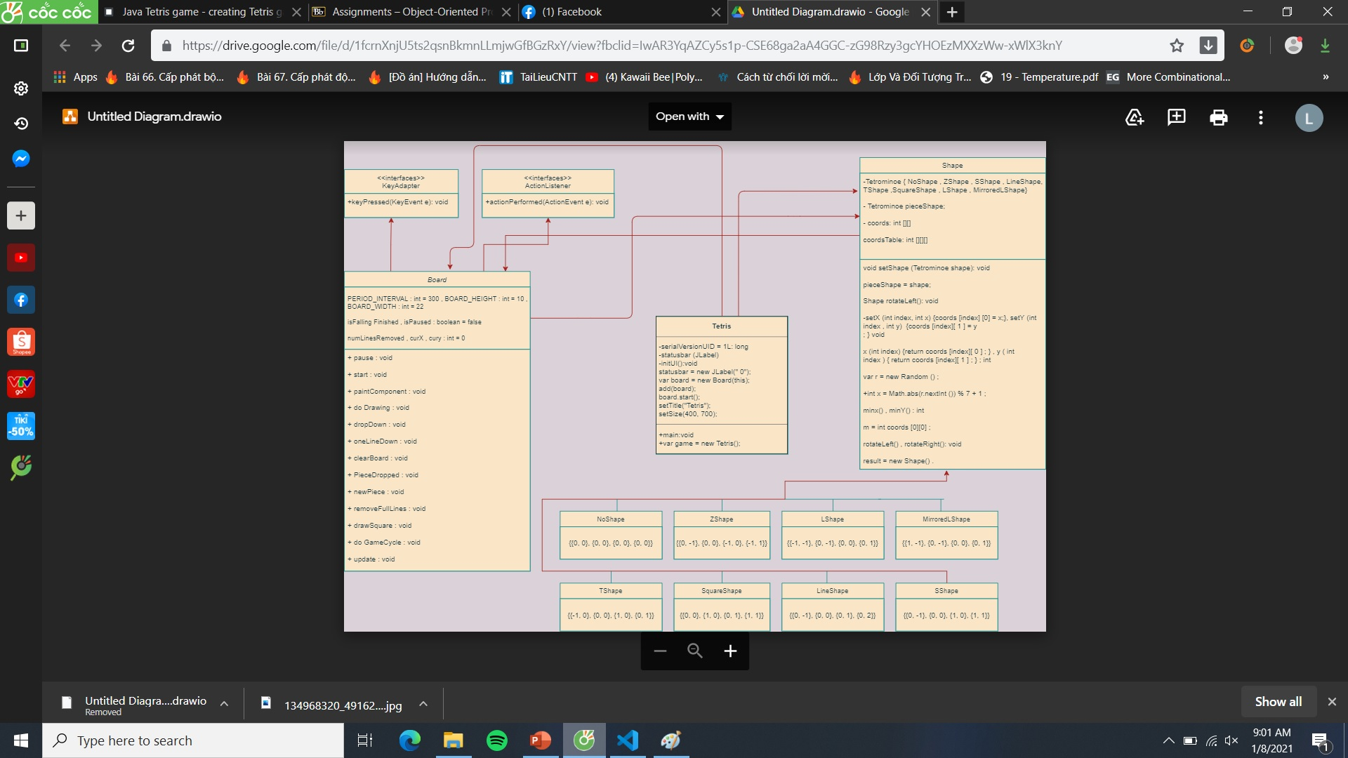

Slide 6
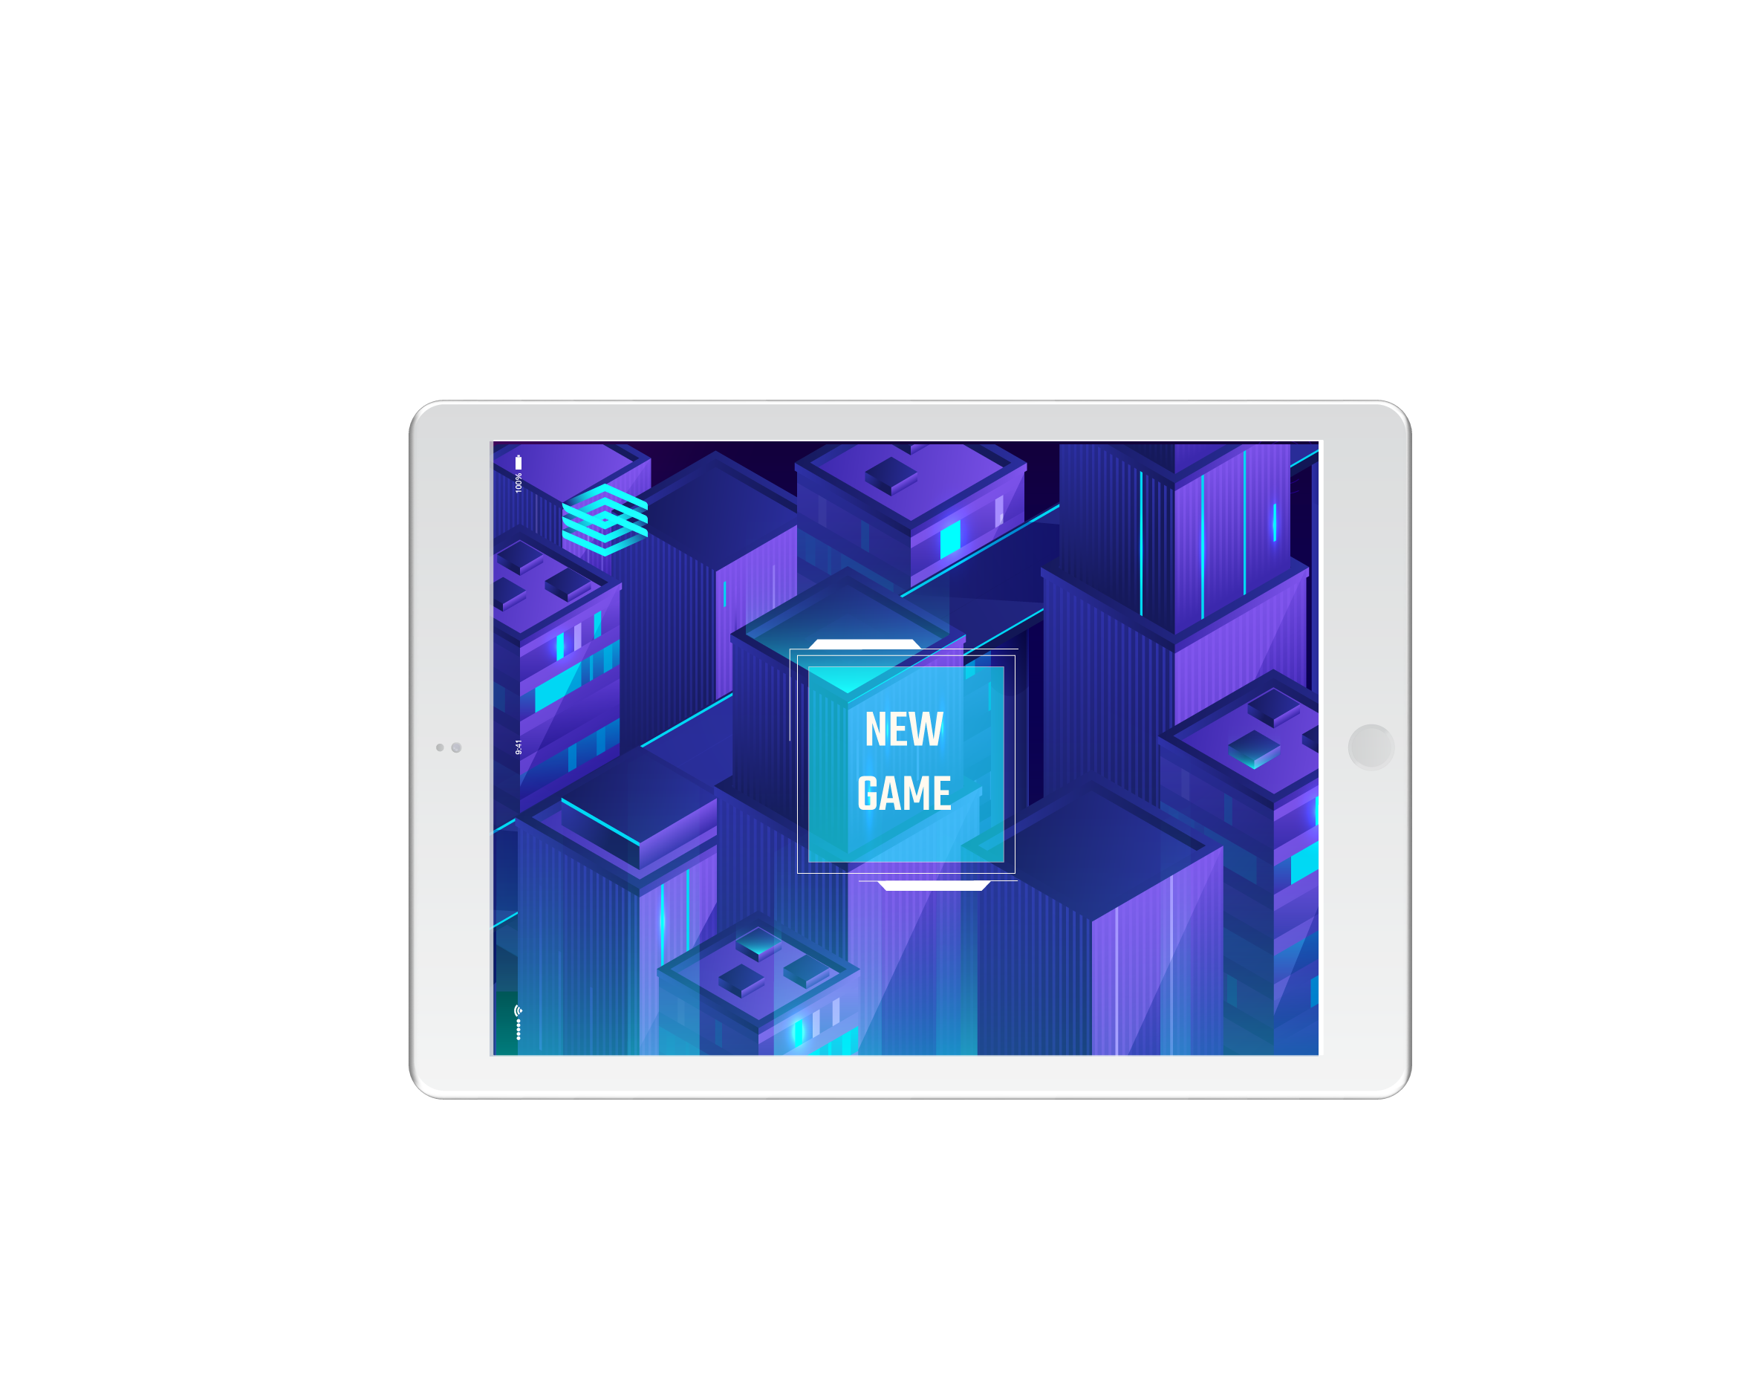
Shape Class Diagram

Slide 7
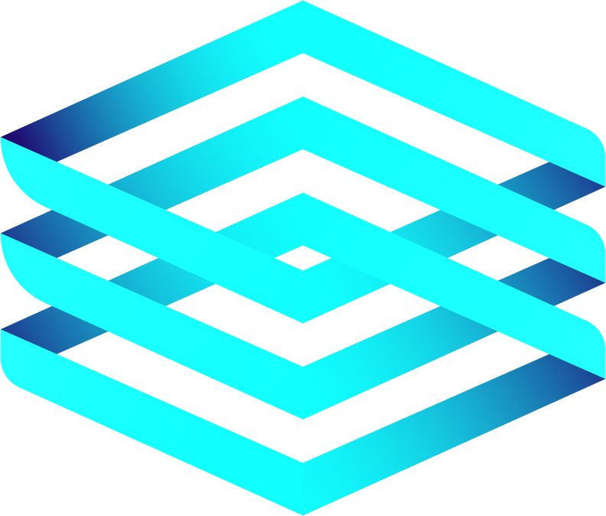
public class Shape {
protected enum Tetrominoe {
NoShape, ZShape, SShape, LineShape,
TShape, SquareShape, LShape, MirroredLShape
}
private Tetrominoe pieceShape;
private int[][] coords;
public Shape() {
coords = new int[4][2];
setShape(Tetrominoe.NoShape);
}

Slide 8
void setShape(Tetrominoe shape) {
int[][][] coordsTable = new int[][][]{
{{0, 0}, {0, 0}, {0, 0}, {0, 0}},
{{0, -1}, {0, 0}, {-1, 0}, {-1, 1}},
{{0, -1}, {0, 0}, {1, 0}, {1, 1}},
{{0, -1}, {0, 0}, {0, 1}, {0, 2}},
{{-1, 0}, {0, 0}, {1, 0}, {0, 1}},
{{0, 0}, {1, 0}, {0, 1}, {1, 1}},
{{-1, -1}, {0, -1}, {0, 0}, {0, 1}},
{{1, -1}, {0, -1}, {0, 0}, {0, 1}}
};
-1
0
1

Slide 9
Shape rotateLeft() {
if (pieceShape == Tetrominoe.SquareShape) {
return this;
}
var result = new Shape();
result.pieceShape = pieceShape;
for (int i = 0; i < 4; i++) {
result.setX(i, y(i));
result.setY(i, -x(i));
}
return result;
}
void setRandomShape() {
var r = new Random();
int x = Math.abs(r.nextInt()) % 7 + 1;
Tetrominoe[] values = Tetrominoe.values();
setShape(values[x]);
}

Slide 10
Board Class Diagram

Slide 11
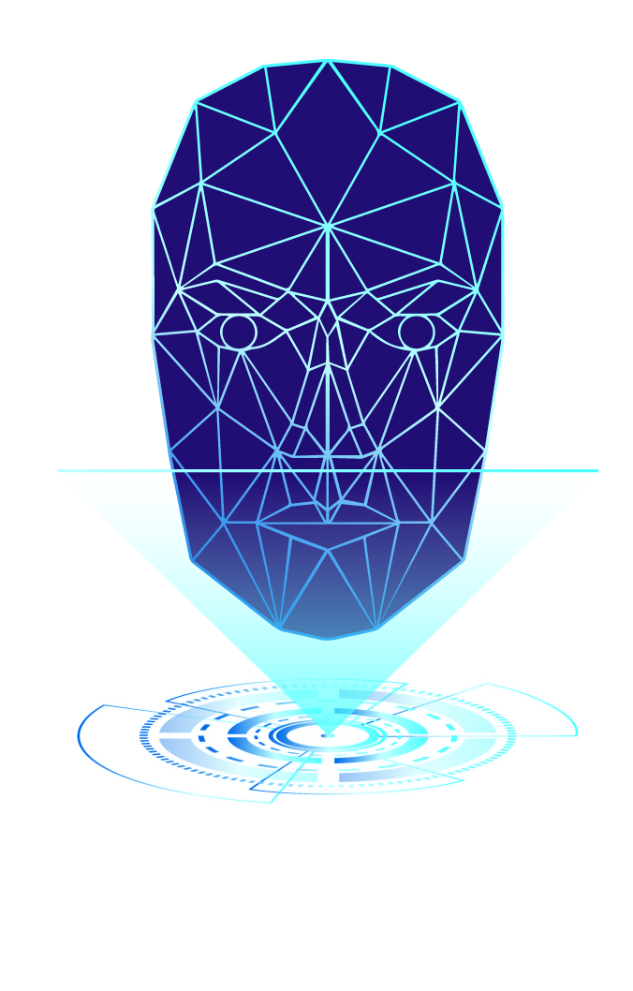
private final int BOARD_WIDTH = 10;
private final int BOARD_HEIGHT = 22;
private final int PERIOD_INTERVAL = 300;
private boolean isFallingFinished = false;
private boolean isPaused = false;
private int numLinesRemoved = 0;
private int curX = 0;
private int curY = 0;

Slide 12
private void pause() {
isPaused = !isPaused;
if (isPaused) {
statusbar.setText("paused");
} else {
statusbar.setText(String.valueOf(numLinesRemoved));
}
repaint();
}

Slide 13
private void doDrawing(Graphics g) {
var size = getSize();
int boardTop = (int) size.getHeight() - BOARD_HEIGHT * squareHeight();
for (int i = 0; i < BOARD_HEIGHT; i++) {
for (int j = 0; j < BOARD_WIDTH; j++) {
Tetrominoe shape = shapeAt(j, BOARD_HEIGHT - i - 1);
if (shape != Tetrominoe.NoShape) {
drawSquare(g, j * squareWidth(),
boardTop + i * squareHeight(), shape);
}
}
}

Slide 14
if (curPiece.getShape() != Tetrominoe.NoShape) {
for (int i = 0; i < 4; i++) {
int x = curX + curPiece.x(i);
int y = curY - curPiece.y(i);
drawSquare(g, x * squareWidth(),
boardTop + (BOARD_HEIGHT - y - 1) * squareHeight(),
curPiece.getShape());
}
}
}

Slide 15
private void dropDown() {
int newY = curY;
while (newY > 0) {
if (!tryMove(curPiece, curX, newY - 1)) {
break;
}
newY--;
}
pieceDropped();
}

Slide 16
private void oneLineDown() {
if (!tryMove(curPiece, curX, curY - 1)) {
pieceDropped();
}
}
private void clearBoard() {
for (int i = 0; i < BOARD_HEIGHT * BOARD_WIDTH; i++) {
board[i] = Tetrominoe.NoShape;
}
}

Slide 17
private void pieceDropped() {
for (int i = 0; i < 4; i++) {
int x = curX + curPiece.x(i);
int y = curY - curPiece.y(i);
board[(y * BOARD_WIDTH) + x] = curPiece.getShape();
}
removeFullLines();
if (!isFallingFinished) {
newPiece();
}
}

Slide 18
private void newPiece() {
curPiece.setRandomShape();
curX = BOARD_WIDTH / 2 + 1;
curY = BOARD_HEIGHT - 1 + curPiece.minY();
if (!tryMove(curPiece, curX, curY)) {
curPiece.setShape(Tetrominoe.NoShape);
timer.stop();
var msg = String.format("Game over. Score: %d", numLinesRemoved);
statusbar.setText(msg);
}
}

Slide 19
private boolean tryMove(Shape newPiece, int newX, int newY) {
for (int i = 0; i < 4; i++) {
int x = newX + newPiece.x(i);
int y = newY - newPiece.y(i);
if (x < 0 || x >= BOARD_WIDTH || y < 0 || y >= BOARD_HEIGHT) { return false;
} if (shapeAt(x, y) != Tetrominoe.NoShape) { return false;
}
}
curPiece = newPiece;
curX = newX;
curY = newY;
repaint(); return true;
}

Slide 20
private void removeFullLines() {
int numFullLines = 0;
for (int i = BOARD_HEIGHT - 1; i >= 0; i--) {
boolean lineIsFull = true;
for (int j = 0; j < BOARD_WIDTH; j++) {
if (shapeAt(j, i) == Tetrominoe.NoShape) {
lineIsFull = false;
break;
}
}

Slide 21
if (lineIsFull) {
numFullLines++;
for (int k = i; k < BOARD_HEIGHT - 1; k++) {
for (int j = 0; j < BOARD_WIDTH; j++) {
board[(k * BOARD_WIDTH) + j] = shapeAt(j, k + 1);
}
}
}
}
if (numFullLines > 0) {
numLinesRemoved += numFullLines;
statusbar.setText(String.valueOf(numLinesRemoved));
isFallingFinished = true;
curPiece.setShape(Tetrominoe.NoShape);
}
}

Slide 22
private void drawSquare(Graphics g, int x, int y, Tetrominoe shape) {
Color colors[] = {new Color(0, 0, 0), new Color(204, 102, 102),
new Color(102, 204, 102), new Color(102, 102, 204),
new Color(204, 204, 102), new Color(204, 102, 204),
new Color(102, 204, 204), new Color(218, 170, 0)
};
var color = colors[shape.ordinal()];
g.setColor(color);
g.fillRect(x + 1, y + 1, squareWidth() - 2, squareHeight() - 2);
g.setColor(color.brighter());
g.drawLine(x, y + squareHeight() - 1, x, y);
g.drawLine(x, y, x + squareWidth() - 1, y);
g.setColor(color.darker());
g.drawLine(x + 1, y + squareHeight() - 1,
x + squareWidth() - 1, y + squareHeight() - 1);
g.drawLine(x + squareWidth() - 1, y + squareHeight() - 1,
x + squareWidth() - 1, y + 1);
}

Slide 23
class TAdapter extends KeyAdapter {
@Override
public void keyPressed(KeyEvent e) {
if (curPiece.getShape() == Tetrominoe.NoShape) {
return;
}
int keycode = e.getKeyCode();
// Java 12 switch expressions
switch (keycode) {
case KeyEvent.VK_P -> pause();
case KeyEvent.VK_LEFT -> tryMove(curPiece, curX - 1, curY);
case KeyEvent.VK_RIGHT -> tryMove(curPiece, curX + 1, curY);
case KeyEvent.VK_DOWN -> tryMove(curPiece.rotateRight(), curX, curY);
case KeyEvent.VK_UP -> tryMove(curPiece.rotateLeft(), curX, curY);
case KeyEvent.VK_SPACE -> dropDown();
case KeyEvent.VK_D -> oneLineDown();
}
}
}

Slide 24
THANKS FOR LISTENING
Does anyone have any questions?
OBJECT-ORIENTED PROGRAMMING
TETRIS GAME PROJECT
GROUP 24

